Slide 1
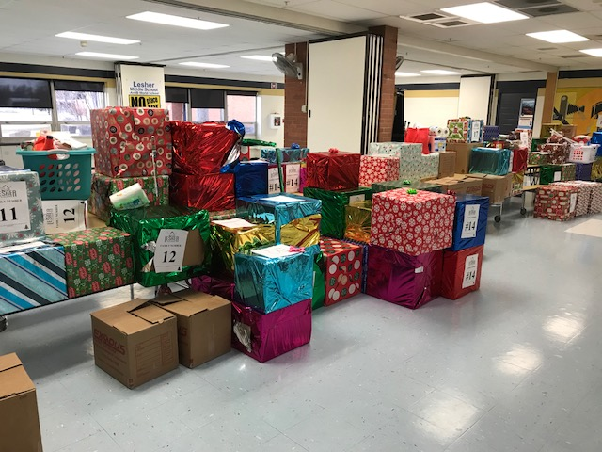
LESHER MIDDLE SCHOOL’S
9TH ANNUAL ADOPT A FAMILY

Slide 2
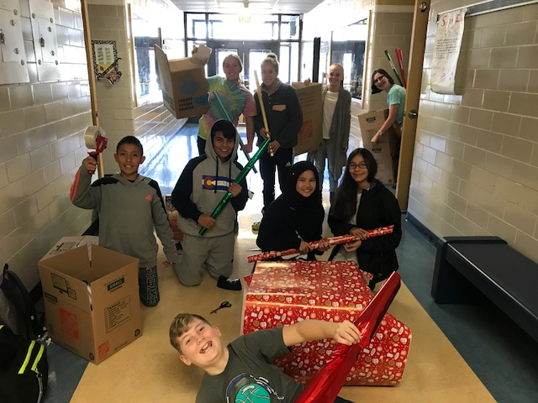
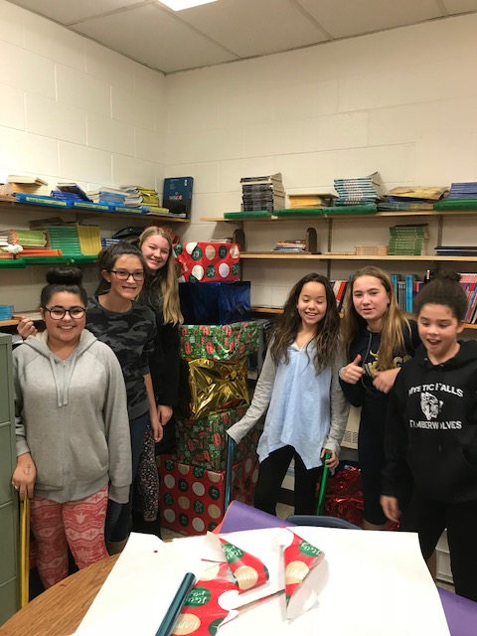
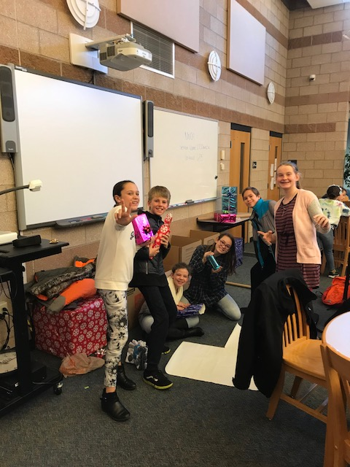
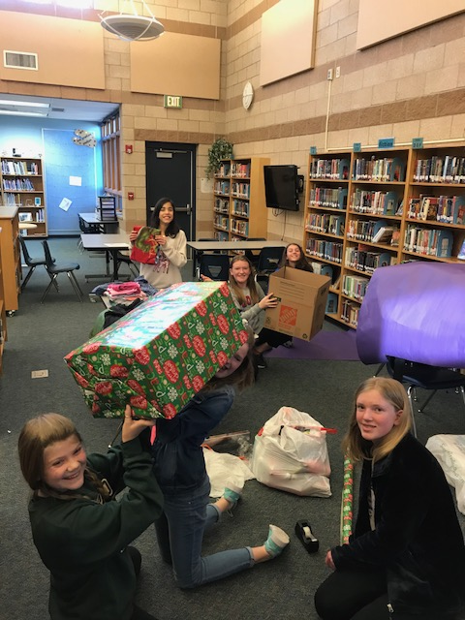
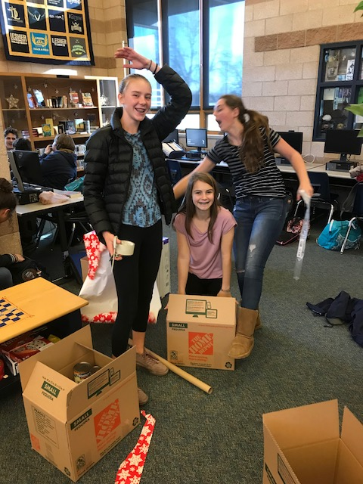
Service in action
Lesher Middle School “adopted” 19 families from our feeder elementary schools that were identified as in-crisis or in-need.
We worked together, gathering items, for 3 weeks to bless these families this holiday season.
In the end, the Lesher community donated approximately $3,000 in gift cards and 150+ boxes filled with food, household items, and gifts to these 19 families! Great Job Vikings!!!

Slide 3
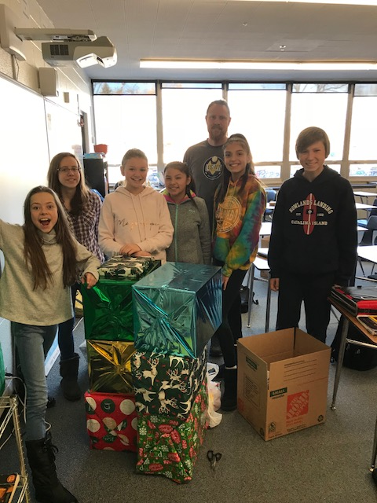
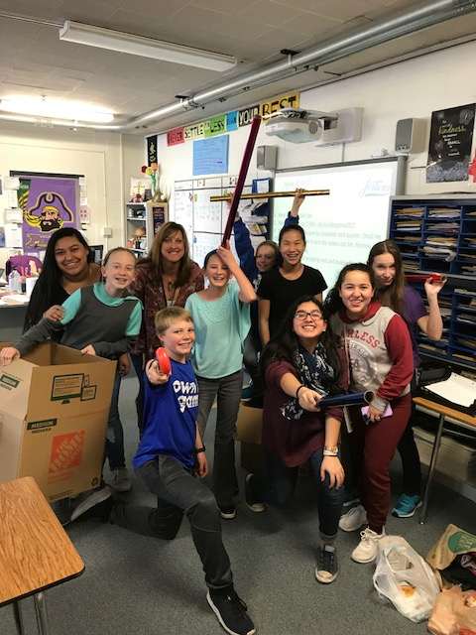
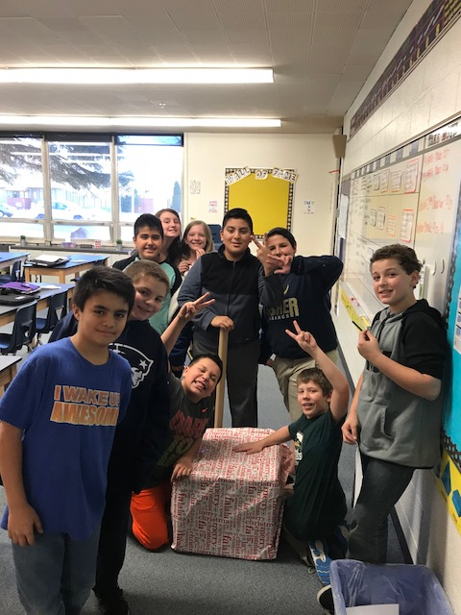
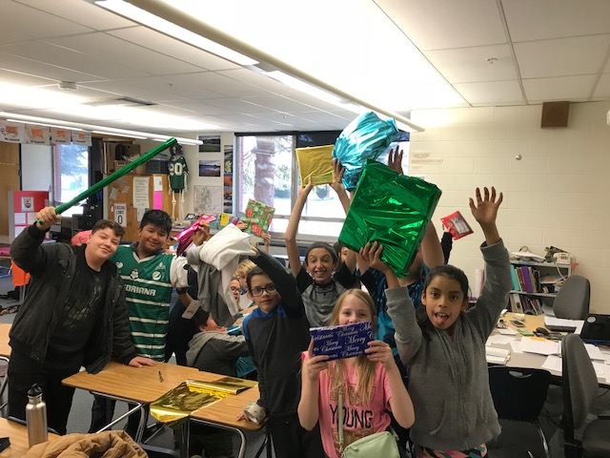
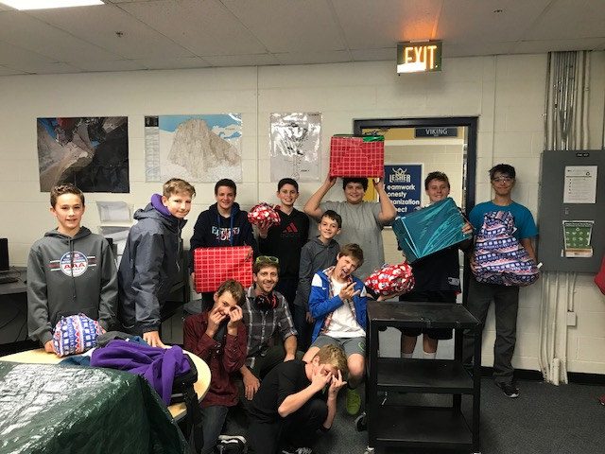
Joyful Givers

Slide 4
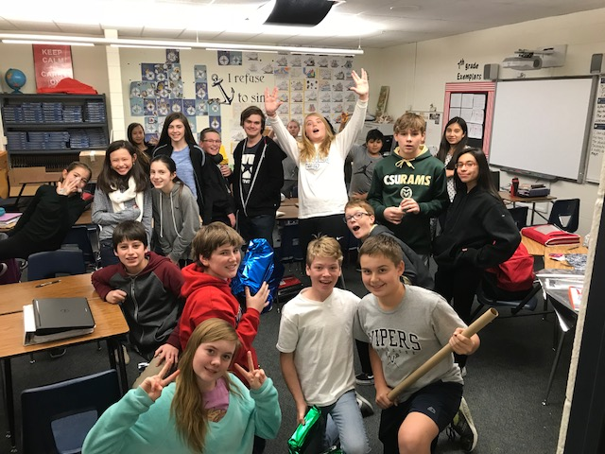
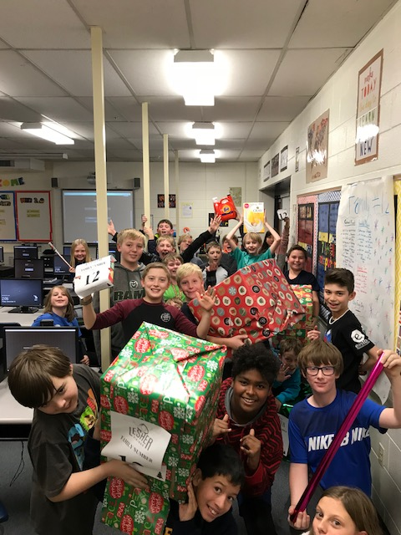
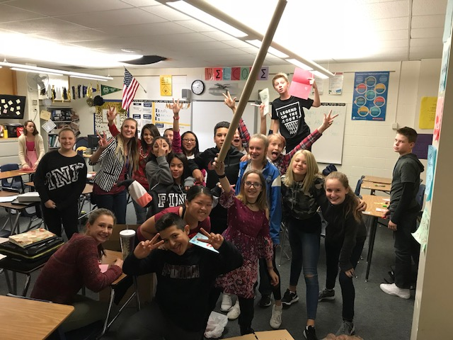
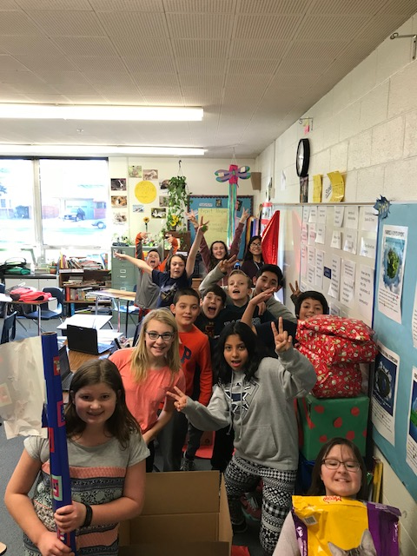
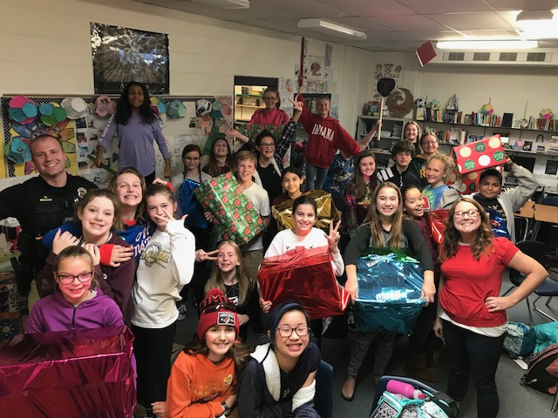
“To give is to fill your own heart with warmth.”

Slide 5
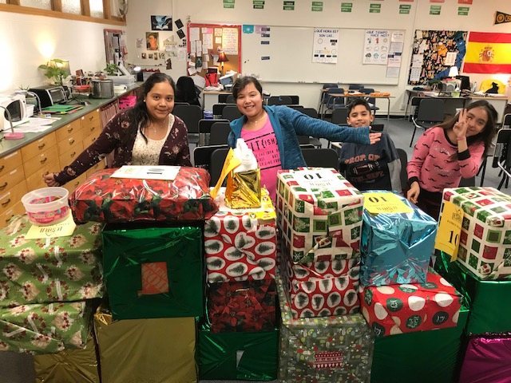
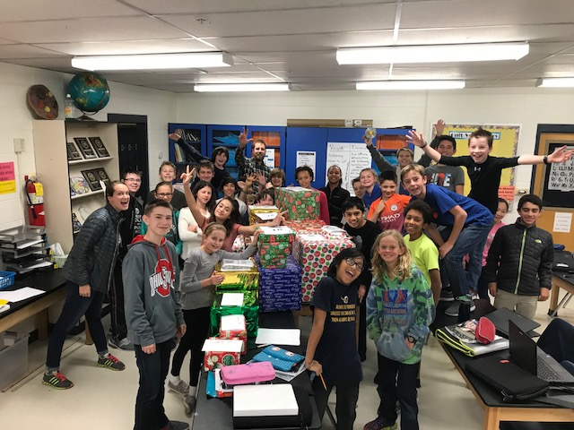
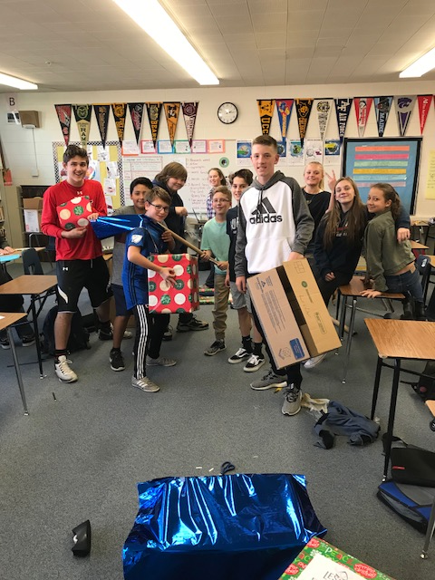
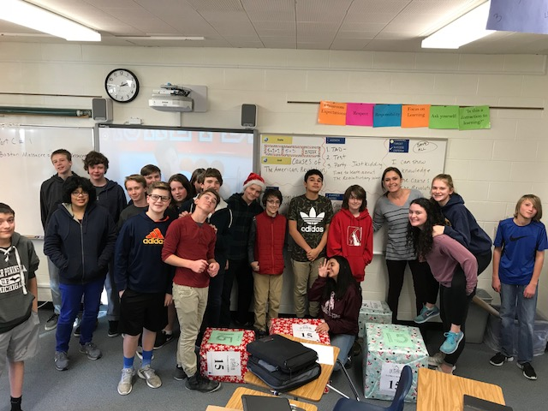
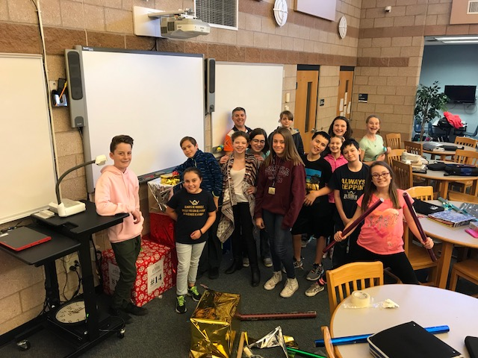
“For it is in giving that we receive.”
-Francis of Assisi

Slide 6
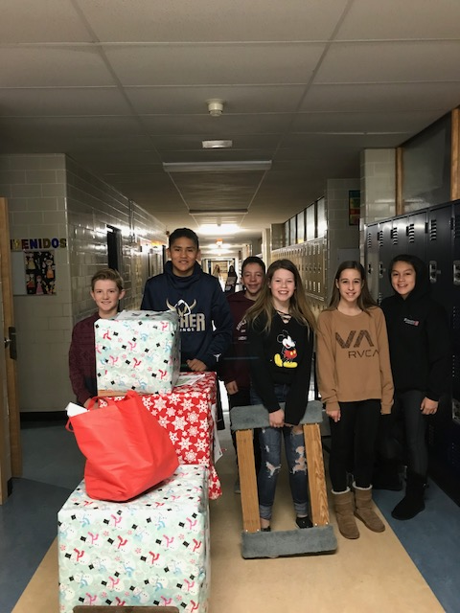
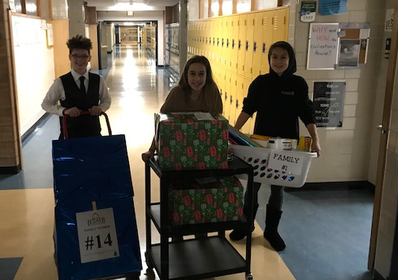
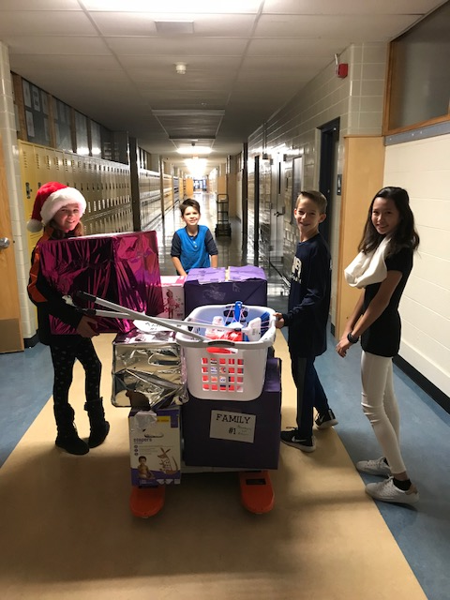
“It's not how much we give but how much love we put into giving.” -Mother Teresa

Slide 7
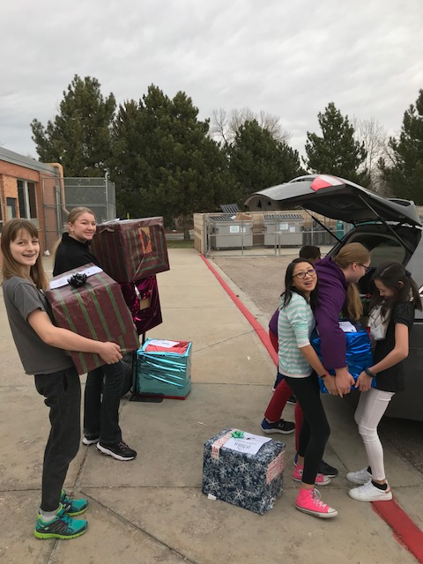
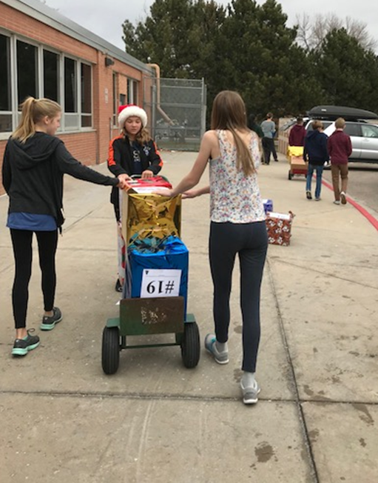
“We make a living by what we get.
We make a life by what we give.”
-Winston S. Churchill

Slide 8
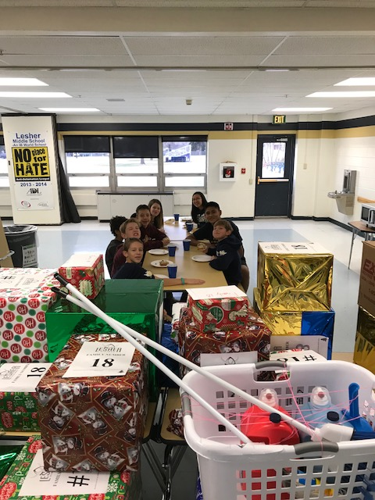
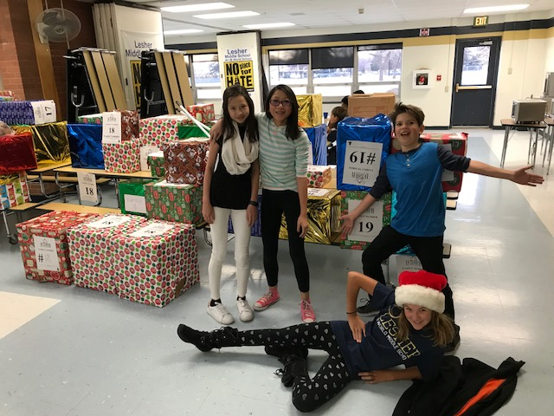
“I slept and I dreamed that life is all joy. I woke and I saw that life is all service. I served and I saw that service is joy.” -Kahlil Gibran

Slide 9
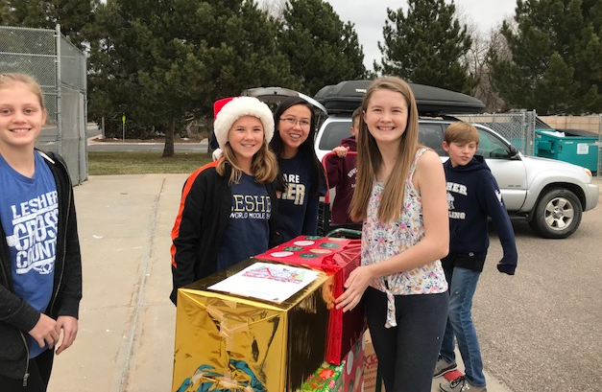
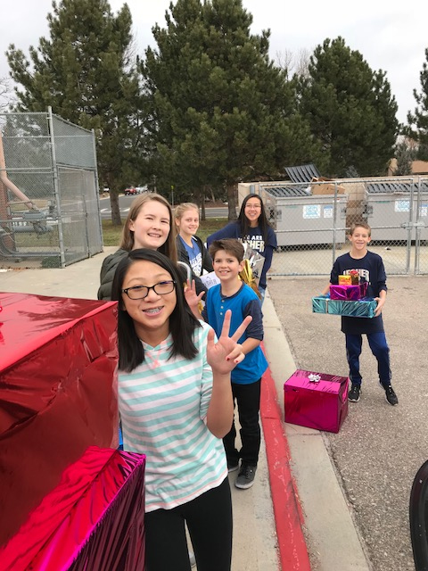
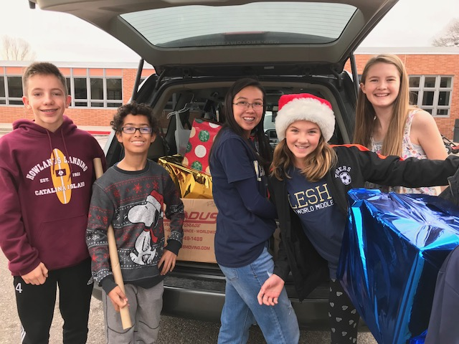
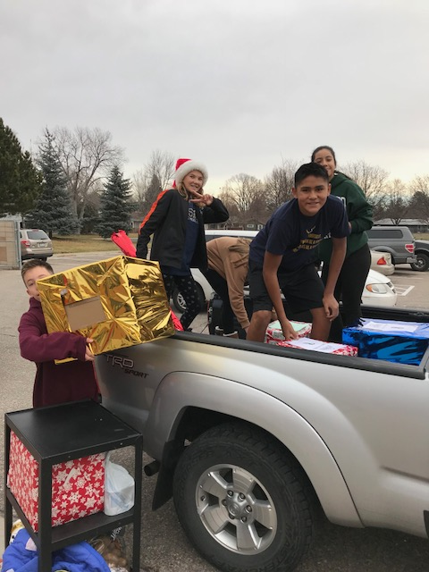
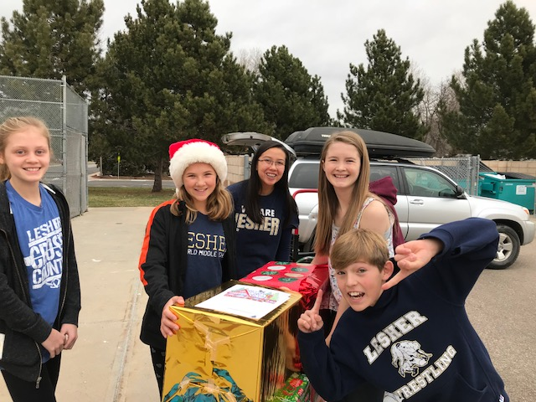
“Have a heart, lend a hand, stand out, and make a difference!”
A special THANK YOU to:
Fort Collins South Home Depot for donating all the boxes!
Connections Church for donating $380 in gift cards!
Chick-fil-A for donating food gift certificates!
Snack Shack and WEB for donating grocery store gift cards!

Slide 10
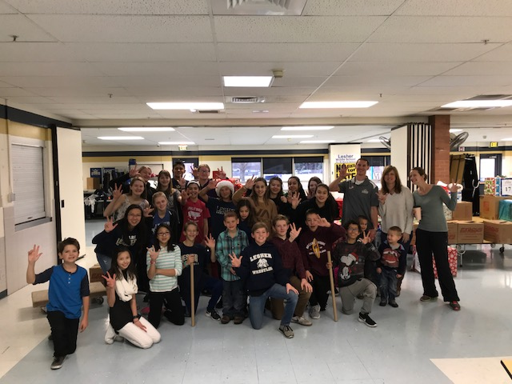
Thank you to the Lesher community, students, and staffulty for donating gifts, your time, and your talents to help these families in need! WE ARE Lesher and we are making a difference!
A special thank you to the following students and staffulty
that helped with our big pickup day for Adopt a Family!
Erica Ciardullo
Brad Cox
Margaret Davis
Rachel Eaton
Sarah Freemyer
Angel Herrick
Waren Morrow
Julieta Herrera-8th
Monica Schafer-8th
Julia Herndon-8th
Shayla Narodowg-8th
Sammy Davison-8th
Oliver Ramirez-8th
Olivia Sherwood-8th
Cade Whish-8th
Andrew Gammon-8th
Emily Beckner-8th
Sofia Leyva-8th
Zayra Coronado-8th
Sam Nosler-8th
Lizzie Narodowg-7th
J.J. Fontana- 7th
Mia Walker-7th
Abbey Ketterman-7th
Trader Verstraeten-7th
Tariq Hirchi-Vogl-7th
Mishka Little-7th
Fulin Tomanek-7th
Emily Piotraschke-6th
Henry Ciardullo-6th

